Slide 1
Mitigating Chicago’s Food Desert: Where is the best location for a new foodbank?
Project Group:
Nichol Flowers, Francisco Galliano, Sunday Joseph, Oladele Lawrence, Antonio San Juan

Slide 2
Summary
Objective: Using food desert, grocery store and HUD data, identify areas within Chicago that would be a good place for a new food bank.
Questions we asked to understand the data we needed:
What defines a food desert?
What is a full service grocery store?
Where are the food deserts in Chicago?
Where are the full-service grocery stores in Chicago?

Slide 3
Definitions
What is a food desert – The USDA defines a food desert as a “low-access community,” at least 500 people and/or at least 33 percent of the census tract's population must reside more than one mile from a supermarket or large grocery store
Why address Chicago’s food desert? Chicago has one with the largest food deserts in the US. Eliminating food deserts promotes greater business activity, reduces healthcare costs and increases economic mobility, etc.
What is a full service grocery store? Retail establishment that sells fresh produce or have healthy food options.
Where full-service grocery stores do not exist or is proximate based on the terms above, we propose the creation of a food bank.

Slide 4
Data Sources
Chicago’s food desert (zip codes, population, income, etc.)
Grocery stores data in Chicago (business size, location, etc.)
HUD census track (census data of select Chicago zip coded)
Sourced from:
USD’s Food Desert databank (Food Desert data)
City of Chicago’s data portal (Grocery Stores data), and
Housing and Urban Development’s census bank
Cleanup & Exploration
3 CSV files cleansed in Python and Excel
Analysis done in Python
Data visualized via Maplotlib and Google Maps

Slide 5
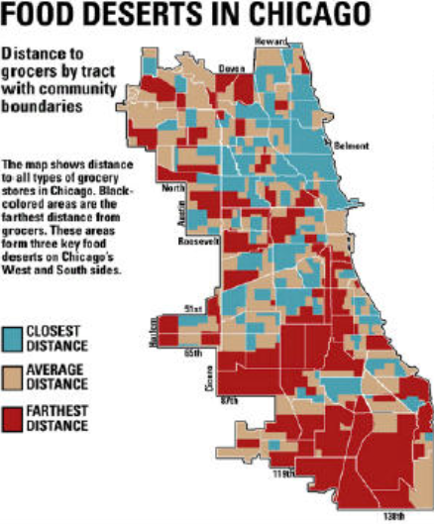
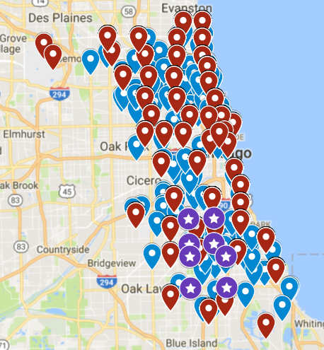
Summary
Map
Legend:
Red – food desert locations
Blue - grocery stores
Stars – selected food desert zip codes

Slide 6
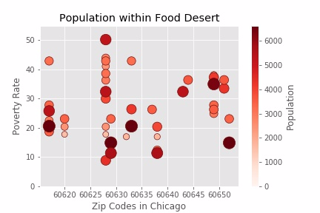
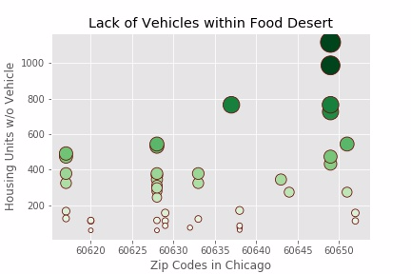
Data Analysis
We looked at identified food desert zip codes.
Then looked at population density, income level and vehicle per housing unit.
Assumption: Food bank should serve the most people with lowest income with the least access.

Slide 7
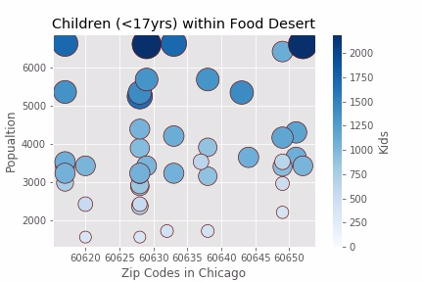
Data Analysis
THE TWO LARGEST SUB-GROUPS ARE CHILDREN AND SENIORS
Notes:
We picked the location with the most children.
And households with the least number of cars.

Slide 8
Community Demographics
43 UNIQUE CENSUS TRACT NUMBERS AND ONLY 13 ZIP CODES
Notes:
Approximately 206,000 individuals counted within these 43 census tracts.
Zip Codes 60629 and 60652 has one of the lowest poverty rates – averaging 16.5% and 19.0%, respectively

Slide 9
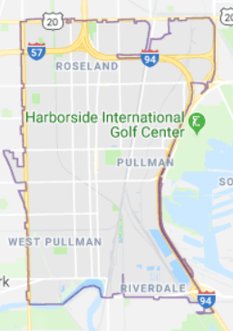
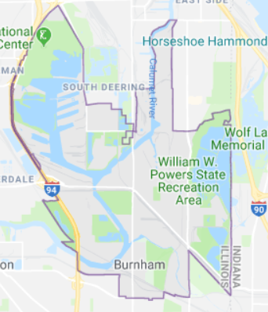
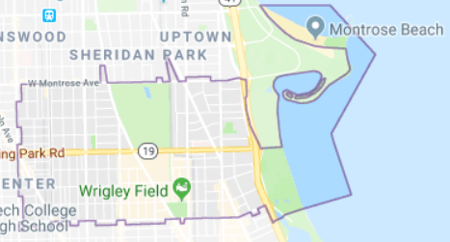
Data Analysis
60628
60617
60633
60617 – Almost ½ is lake area, Graceland Cemetery and Wrigleyville. Reject!
60628 and 60633 are best places for a food bank!
Southside, minority-majority population, lower income levels with modest access to transportation.
Notes:
60628 contains the a section where the poverty rate is 50% of the population. Population in this Census Tracts is ~40,000 and the largest of all areas reviewed.

Slide 10
Questions?

Slide 11
Findings & Post Mortem
LIMITATIONS OF OUR DATA:
Include only large retailers. There are a number of small stores in the Chicago.
There are alternative and reliable modes of public transportation (“L”, Metra, CTA).
Data tells a story but inconclusive for pinpointed an exact location for Food Bank.
Need to better translate Census Tracts map and income and access levels further.
Need to complete a cost analysis (Start-up and Operational) current resources.
Our analysis would improve if we included more socio-economic indicators (e.g. include all businesses, public transportation).
Given more time we would pull more data and create more KPIs.
Notes:
Vehicle access is limited to private vehicles.

